Slide 1



VISVISVESVARAYA TECHNOLOGICAL UNIVERSITY Jnana Sangama, Belgavi – 590018
AKSHAYA INSTITUTE OF TECHNOLOGY
DEPARTMENT OF COMPUTER SCIENCE AND ENGINEERING
Internship presentation
on
“Machine Learning With Python”
“Virtual Assistant for Visual Impaired”
Submitted by:
Gururaj Kondaguli(1AK19CS014)
Guided by
Mrs Nandini
Sain Informatix.

Slide 2
OVERVIEW
ABOUT THE COMPANY
ABOUT THE DOMAIN
INTRODUCTION TO PROJECT
IMPLEMENTATION
SNAPSHOTS AND SCREENSHOTS
RESULTS
APPLICATION

Slide 3

ABOUT THE COMPANY
Introduction:
Sain Informatix is a Private company incorporated with the sole purpose of making a change in the tech world. It is classified as Non-govt Company and is registered at Registrar of Companies, Bangalore. Compsoft Technologies is a research and development centre and educational institute based in Bangalore.
Purpose:
They are focused on providing quality tech support on latest technologies and develop products which are of great need to the society. They run a project consultancy where they undertake various projects from wide range of companies and assist them technically and build products and provide services to them. They are continuously involved in research about futuristic technologies and finding ways to simplify them for their clients.

Slide 4
Mission:
To be a world-class research and development organisation committed to enhancing
stakeholder’s value by providing technical services.
Vision:
To build best products that is socially innovative with high-quality attributes and provides excellent tech support to all.

Slide 5
Company services-
Sain Informatix offers various services such as Real-Time Projects, Android App Development, Training etc.
Software Development-
Our applications are developed using latest technologies, which gives better performance, stability, scalability, maintainability, reliability and extensibility to applications.
Android App Development –
Android Application using GPS, Bluetooth, JSON, Accelerometer, Telephony, Mobile Cloud etc.
Training-
Cost-effective, convenient and easy-to-manage individual/group class room training on Software Courses, Matlab, VLSI etc.
Real Time Projects-
Projects on various technologies like C, C++, Java, Dotnet, PHP, Embedded, Python, Robotics, IoT, Machine Learning, Artificial Intelligence, Mobile Apps etc.

Slide 6
Company Departments:
IT Department – it’s the core of every software house company, its created by the group of professionals who are doing the actual technical part of the project.
Product Development –under this we have Software development service, cloud Consulting.
Software Development Services-Python Development Services, python is a language using which Real-Time Application can be build. Similarly we have other service such as Java Development Services, using Java Websites or Online Application can be build.

Slide 7
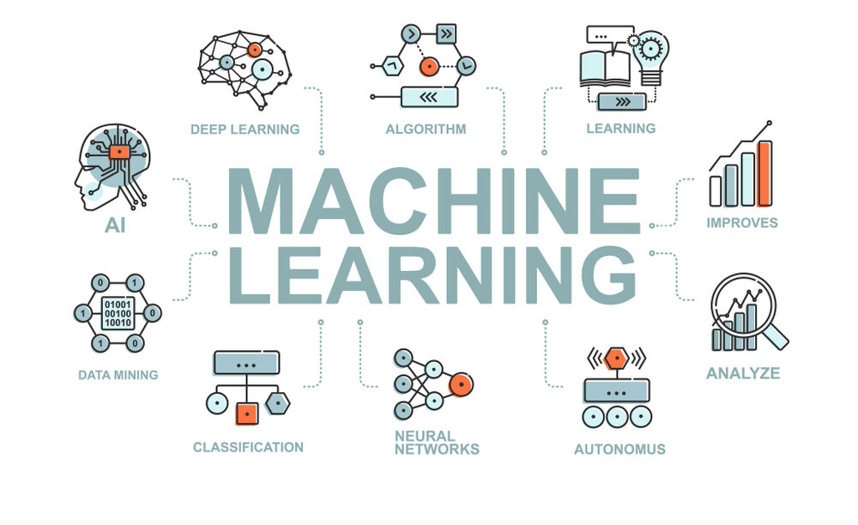
ABOUT THE DOMAIN
Machine Learning is the branch of computer science that deals with training and the creation of intelligent computer programs called as Machine Learning Models. These models can be trained on any kind of data and then used to predict values of missing data or desired data. Machine Learning has recently gained a lot of attention due to major breakthroughs in the same field. Although it is not very new technology and has been around for a while.
Machine Learning has vast applications and can be used to create intelligent computer systems.

Slide 8
INTRODUCTION TO PROJECT
Abstract
Interacting with mobile applications can often be challenging for people with visual impairments due to the poor usability of some mobile applications. The goal of this paper is to provide an overview of the developments on usability of mobile applications for people with visual impairments based on recent advances in research and application development. This overview is important to guide decision-making for researchers and provide a synthesis of available evidence and indicate in which direction it is worthwhile to prompt further research. We performed a systematic literature review on the usability of mobile applications for people with visual impairments.

Slide 9
Objective:
The objective of the implementation of this system is to develop a machine learning model that can distinguish between vast set of emotions based completely on the voice of the subject. The Model can then be trained using testing data and training data to get better at detecting the emotions of the subject.

Slide 10
Problem Statement:
To develop an application for visually impaired people to assist them and to perform the tasks using voice commands..

Slide 11
IMPLEMENTATION
Development Tools:
Android Studio.
Python 3.9
Python Modules.
JDK

Slide 12
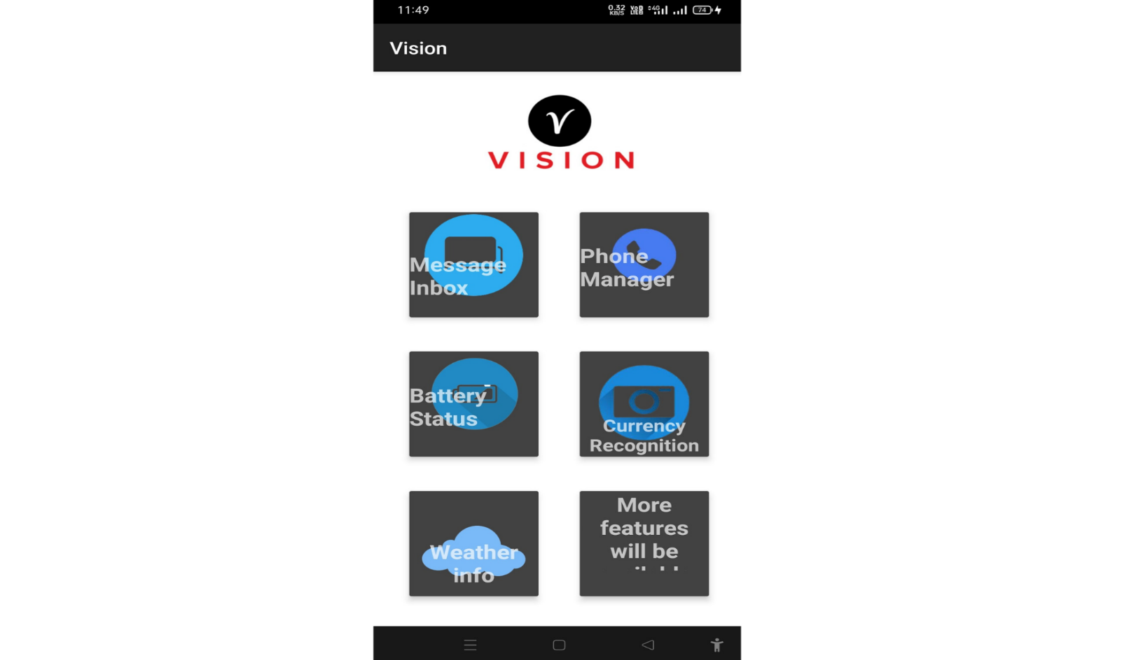
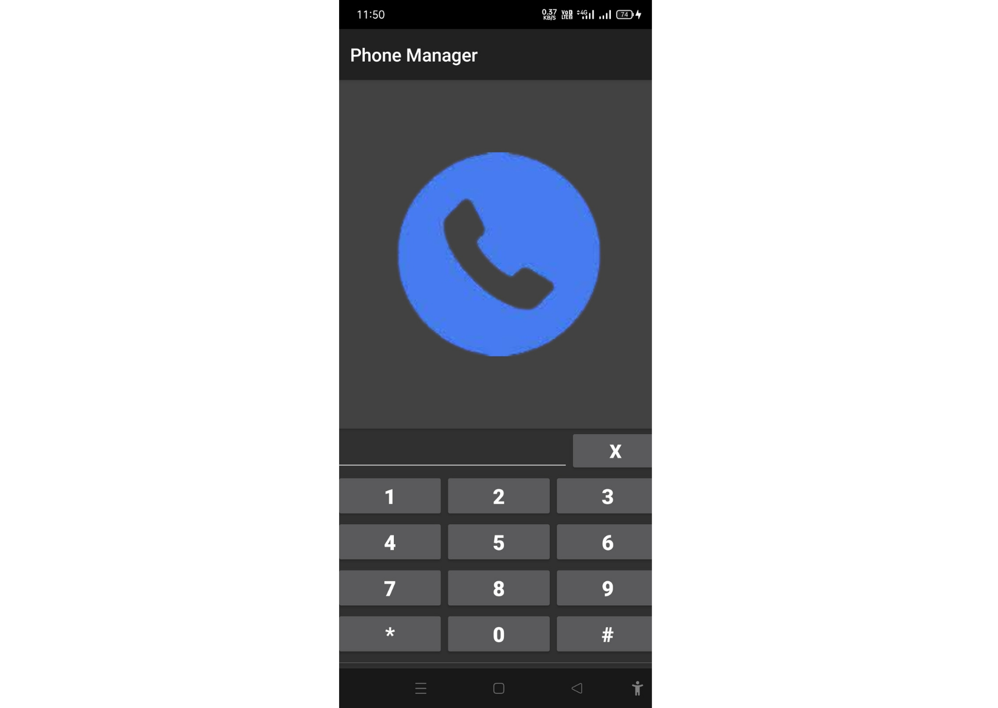
Snapshots

Slide 13
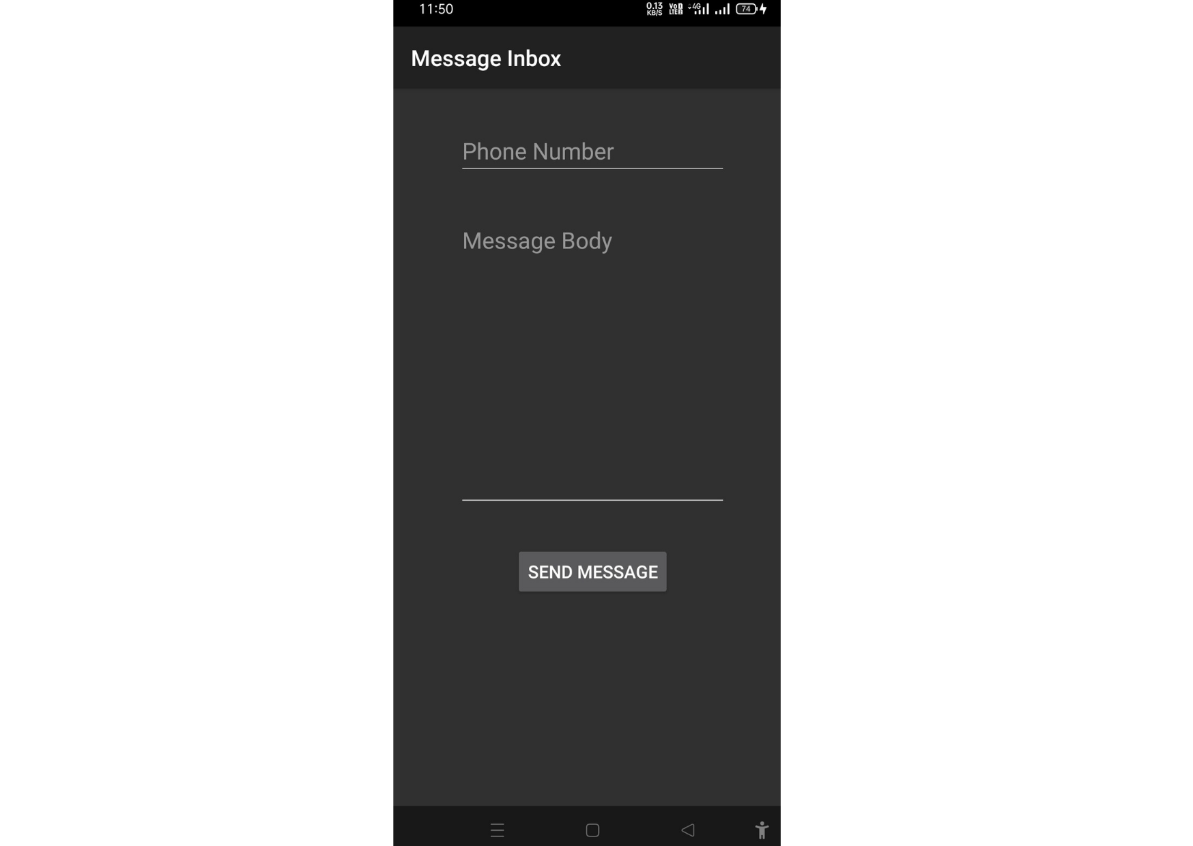
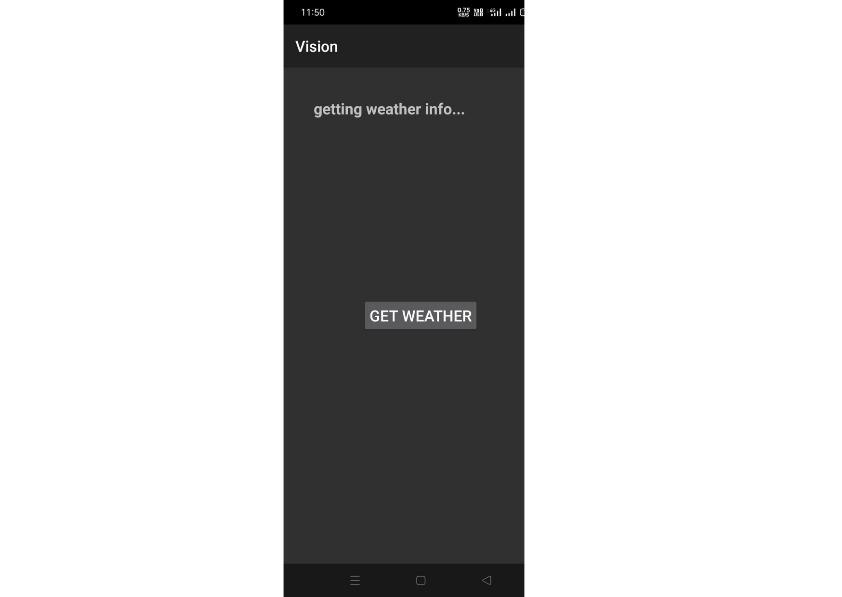
Snapshots

Slide 14
RESULT
Interest in Machine Learning and Deep Learning has exploded over the past decade. You see machine learning in computer science programs, industry conferences, and in many applications
in daily life. I am assuming you already know about Machine Learning, therefore I will not be explaining What and Why. So, I find many beginners facing problems while installing libraries and setting up the environment. As I have faced the first time when I was trying. So this guide is totally for beginners.

Slide 15
APPLICATIONS
This is an innovative System for visually impaired people and acts as a voice assistant for them. This system is used to help the visually impaired to have access to the most important features of the phone enhancing the quality of the system making use of different custom layouts and using speech to text.
The System has custom messaging feature with inbox and sent items, call log and dialer, notes and battery level checking and reminder. All actions performed by the user the system speaks out and helps the user to know his current position.
The System helps the user to also read the contents of the message along with the sender and the date and time, in whole everything.
The system also allows the user to note few things with its custom note pad .The System speaks out the dialer number pressed and called notification also. The System in all is a voice assistant for whatever action the user has performed though a custom app while taking the data from the default application. The custom app doesn’t save any data it is dependent on the phones data.

Slide 16
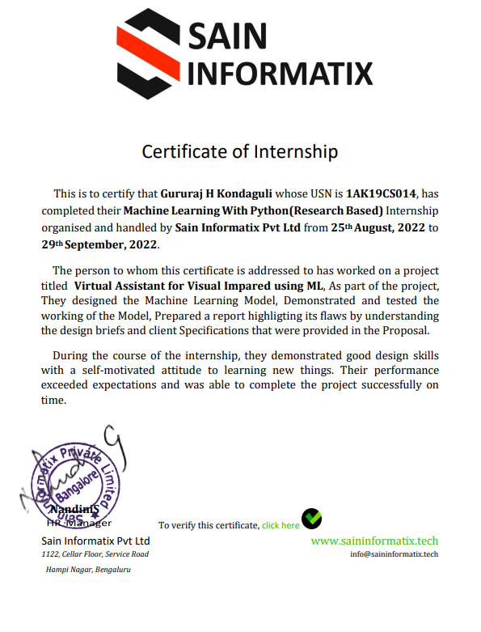
CERTIFICATE

Slide 17
THANK YOU

